Slide 1
The Aging Experience in Our Community
Key issues for Community Consideration

Slide 2
BRC Speakers Bureau
Share our experience and knowledge of healthy aging
Working with community partners to raise of awareness of the needs of Seniors in the Harrisonburg City, Rockingham County and Augusta County communities
Making connections with civic groups and other nonprofits to create future partnerships to benefit the communities where we live and work

Slide 3
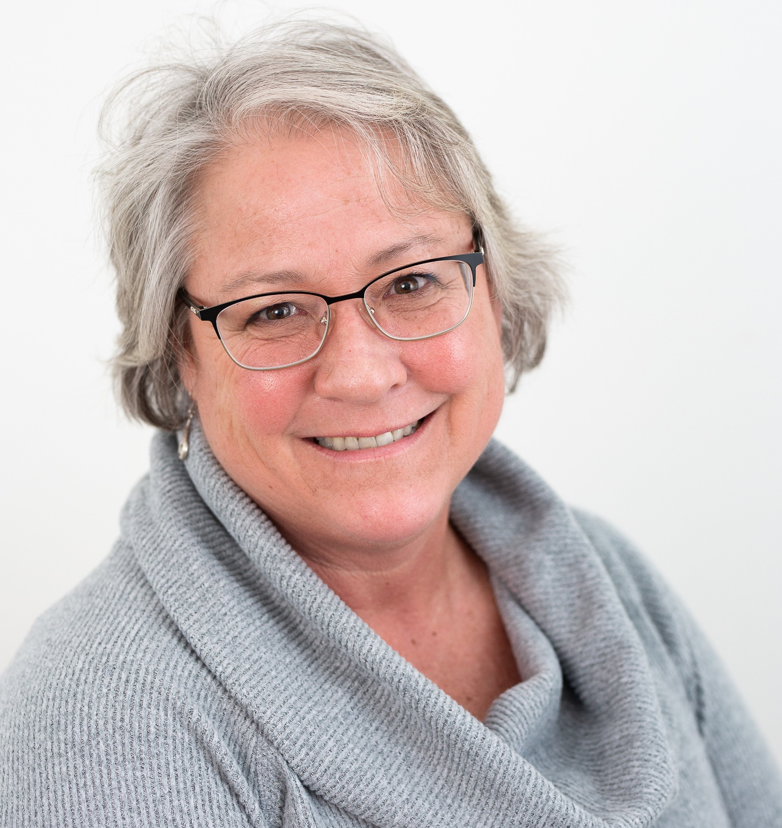
Beth Bland Director of Senior Services Harrisonburg, Rockingham County & Development, Marketing, and Communications Director VPAS Carrie Budd
Vice President for Development and Community Relations
Bridgewater Retirement Community

Slide 4
Project Background – Senior Community Needs Assessment
Westminster Canterbury of Richmond – study in 2016
Bridgewater Retirement Community Strategic Plan Initiative
Partnered with VPAS and Holleran

Slide 5
Project Goal
To better understand and prioritize the needs of older adults and their families in
Rockingham and Augusta Counties and the City of Harrisonburg, Virginia

Slide 6
Project Data Sources
Secondary Data – Information from Resources such as:
U.S. Census Bureau, Centers for Disease Control and Prevention, Centers for Medicare and Medicaid, Community Commons, and The Nielsen Company
Key Informant Survey
June/July 2019
83 Online Survey Completions
Older Adult Community Survey
August – October 2019
752 Survey Completions
Caregiver Feedback
September/October 2019
93 Survey Completions

Slide 7
Key Findings
Affordable Housing
Social Isolation
Navigating the Healthcare System

Slide 8
Secondary Data Findings
By 2024, 65 and older adults will account for
24% of the population in Augusta County
22% in Rockingham County
10% in Harrisonburg(closer to 20% without JMU)

Slide 9
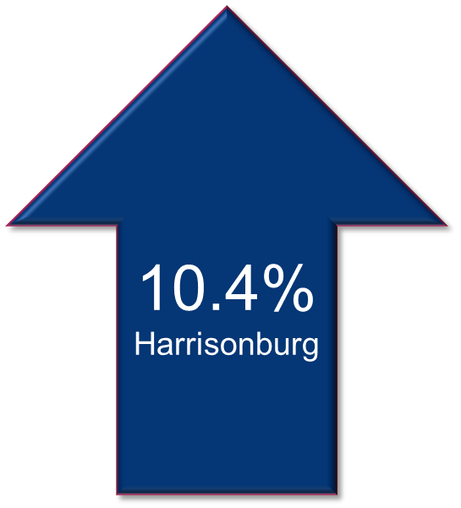
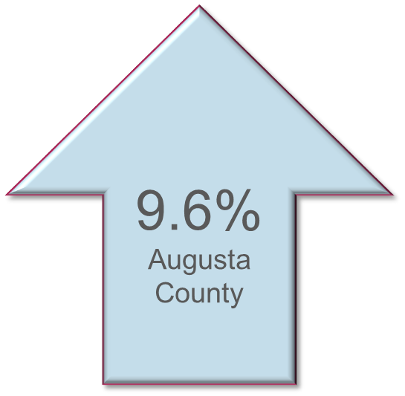
2020 ALICE Study Findings Older Adult Population Below 100% Poverty Level

Slide 10
Demographic Highlights
54% of Seniors in Rockingham County pay more than 30% of their income on housing
Significant shortage of healthcare providers (Medical, Mental and Dental)
17% have been told they have a major depressive disorder

Slide 11
Overview: Key Informant Survey
Targeted community stakeholders in Rockingham and Augusta Counties as well as Harrisonburg City, with expert knowledge about the needs of older adults
Professions include Government, Housing, and Transportation, Social Services, Health Care Professionals, and Not-For-Profit Leaders
83 responses were collected during June and July 2019

Slide 12
Most Significant Barriers to Health Care According to Key Informants
Lack of Transportation
Inability to pay out of pocket expenses
Inability to navigate the healthcare system
Notes:
All selected over 50% of the time

Slide 13
Missing/Lacking Services
Free/Low-Cost Dental Care
Free/Low-Cost Vision Care
Memory Care Specialists
Geriatricians/Gerontologists
Respite Care
Caregiver Support Services
Notes:
All selected by more than 50% of respondents.

Slide 14
Top 5 Most Pressing Issues
Navigating/accessing health care and social services
Chronic disease management
Poverty/financial insecurity
Alzheimer’s disease/dementia/memory loss
Transportation
Notes:
Key informants were asked to select the Top 5 most pressing issues, then asked to select the 1 that is the most significant.

Slide 15
Overview: Community Survey
Targeted to people 65 and older living in the city of Harrisonburg and Augusta and Rockingham Counties
Utilized online and written methodology
Assessed demographics, needs, and interest services
752 responses were collected from
August – October 2019

Slide 16
71%
of the community feel affordable housing for seniors is Extremely or Very Important
67%
of the community feel access to Home Health Care is Extremely or Very Important

Slide 17
The majority (58%) feel connected to the community.
40% would like more affordable events geared towards older adults.

Slide 18
Over
participate in family gatherings,
go to restaurants, or church activities.
79%
40%
Would like to participate in lifetime learning opportunities.

Slide 19
Greatest Transportation Need
Doctors’ Appointments
(33%)
Grocery Stores
(22%)

Slide 20
Least Accessible Healthcare Services
Affordable, well-trained, certified home health care providers
Health and wellness programs
Information on health, housing and other services
Home care services

Slide 21
Overview: Caregiver Survey
Targeted caregivers who are specifically addressing the needs of an elderly parent, friend or spouse
93 responses were collected during September/October 2019
82% Female Caregiver
73% of Caregivers were 65 or older
Caregiver Relationship
41% Spouse
23% Family Member
20% Parent

Slide 22
Most Pressing Issues According to Caregivers
Top 6 Most Pressing
Alzheimer’s Disease/Dementia/Memory Loss
Lack of Knowledge about Available Services
Maintaining Independence at Home
Injuries/Falls
Chronic Disease Management
Social Isolation
Notes:
Caregivers were asked to select the Top 3

Slide 23
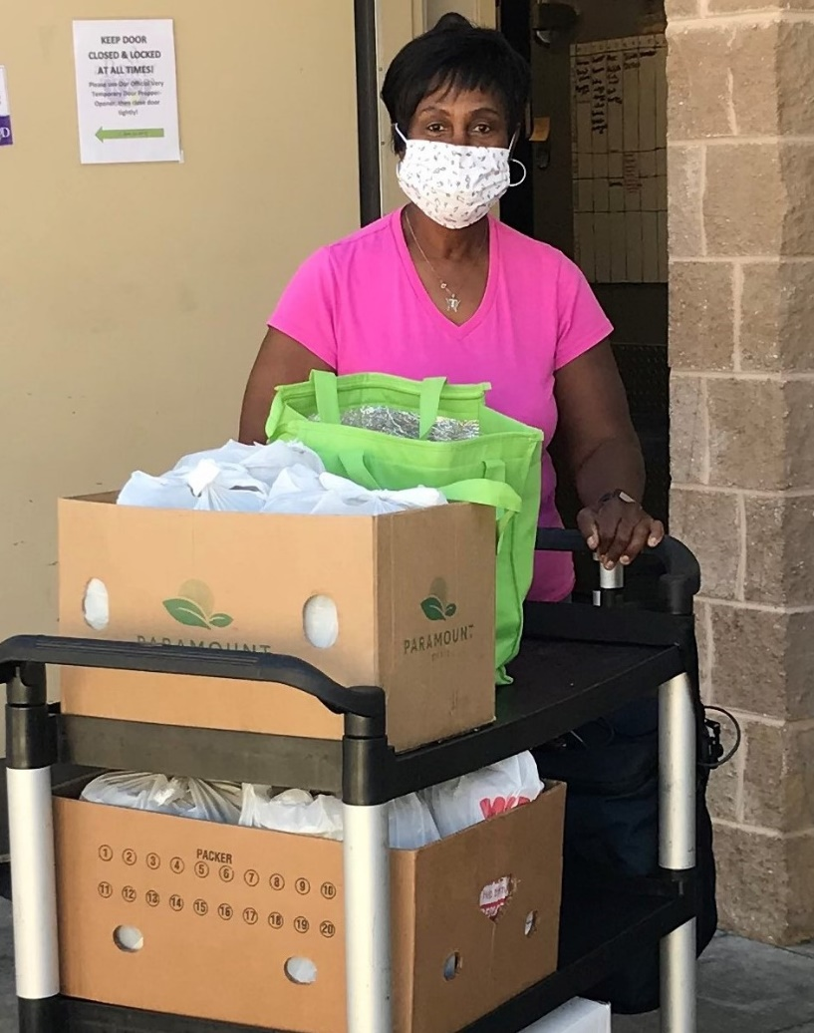
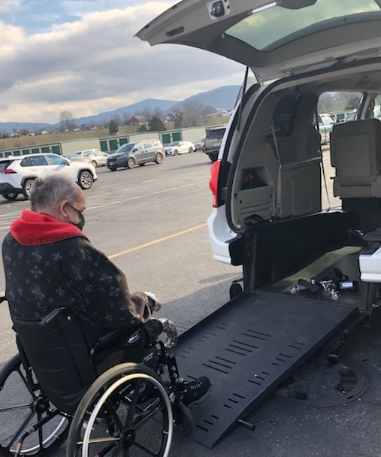
Valley Program for Aging Services (VPAS)
Who Are We?
Non-Profit Organization est. 1974 (AAA)
Planning District 6
Serve adults 60 years and older and their caregivers
What Do We Offer?
Community Based Services
Information, Assistance, Referral
Medicare Counseling
VPAS Cafes
Adult Daycare
Transportation
Health and Wellness Programs
Caregiver Support
Caregiver Respite (CCN)
In-home Services
Assessment
Meals on Wheels
Homemaker

Slide 24
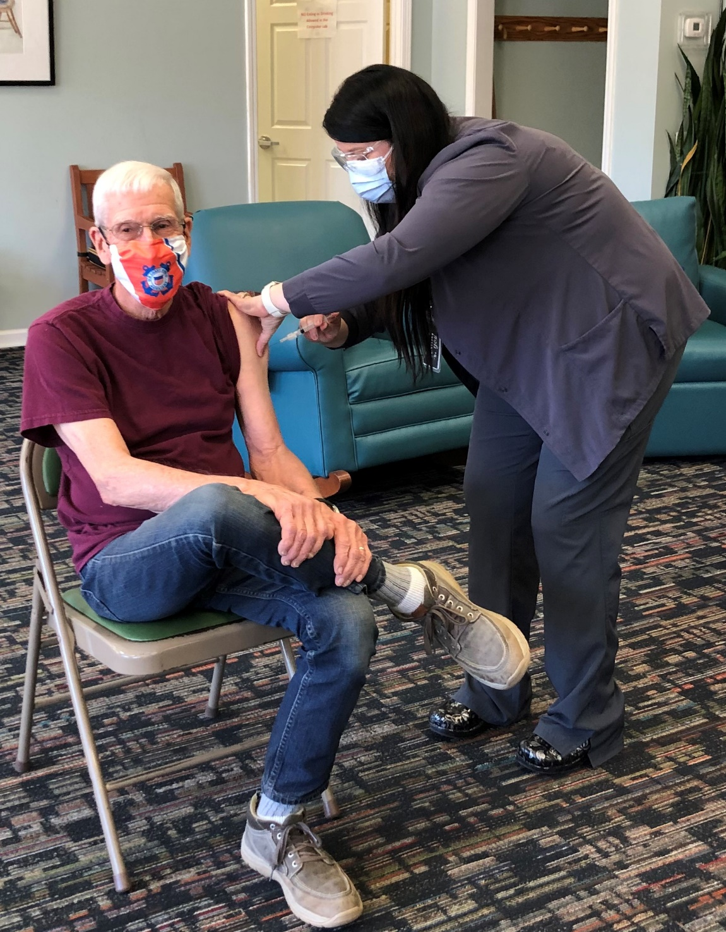
VPAS During the Pandemic
What Happened?
Doors closed, services went to phone support
Meal delivery 1 day/wk
Additional food support
Telephone Checking Program
Hygiene bags
Distribution of Masks
Activity kits
Nutrition Drinks
Emergency Groceries
Adult Undergarments
Virtual Programs
Caregiver Support
Where Are We Now?
Assisting with scheduling vaccines
Planning to re-open to in person services July 2021
Increase meal deliver to 2-3 days/wk
Implementation of RING
Gradual return of volunteers
Home visits resume
Centers re-open as Cafes
Caregiver Respite (CCN) returns to in-person visits Spring 2022

Slide 25
Going Forward
Share results with the community (Key informant symposium and Speaker Bureau)
Website – ValleySeniors.info
Partnerships with other nonprofits
BRC corporate initiative

Slide 26
Contact Information
Carrie Budd
Email – cbudd@brcliving.org
Phone – 540-828-2509
Beth Bland
Email – Beth@vpas.info
Phone – 540-615-5341
Tune into to “Issues in Aging” 550 am / 92.1 FM
4th Monday of each month, 9:15 am

